Slide 1
FREE MEDICAL CAMP
DATE – 05.01.2025
LOCATION – AYYANA PRIMARY SCHOOL KALATHUR, KAUP

Slide 2
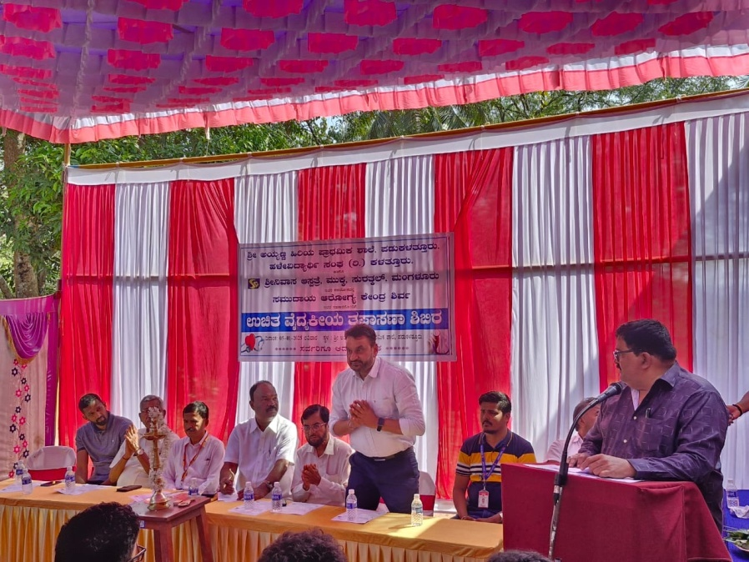
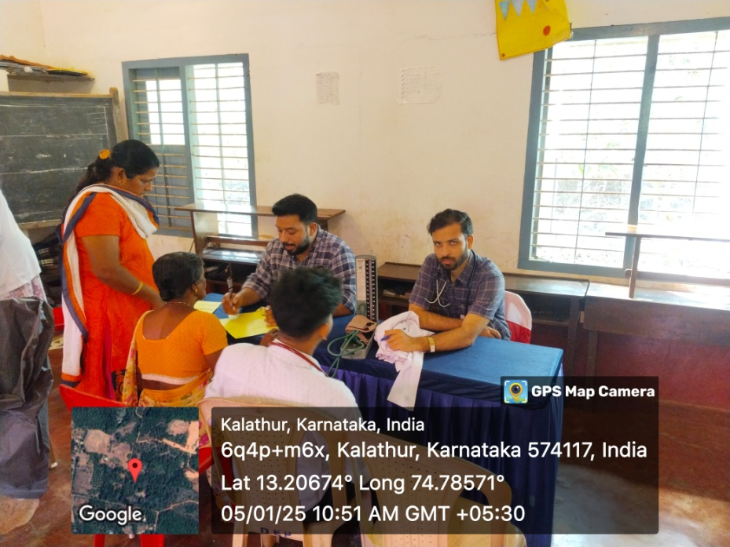
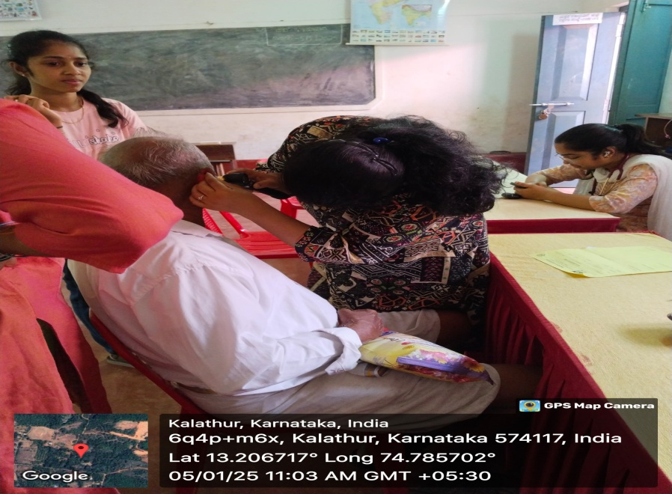
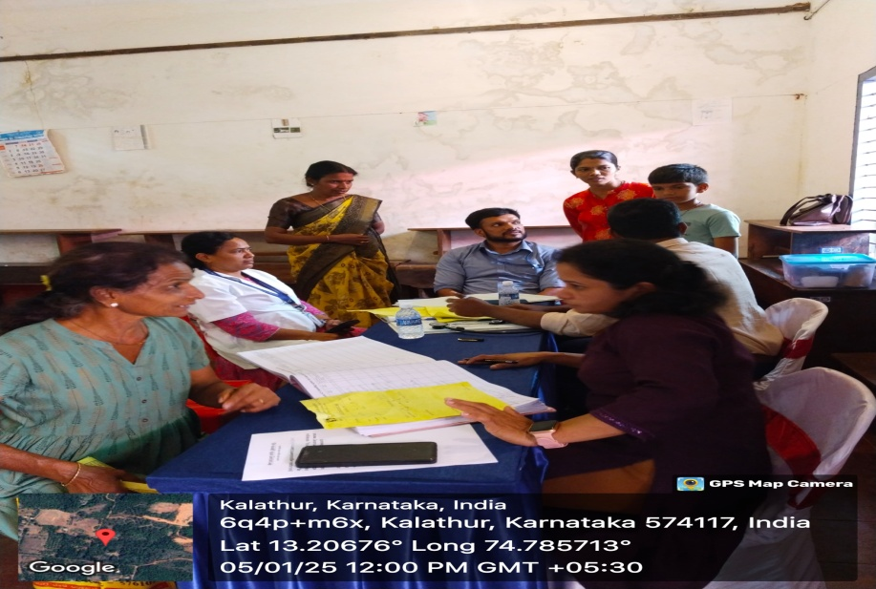

Slide 3
FREE MEDICAL CAMP
DATE – 12.01.2025
LOCATION – GOVERNMENT HOSPITAL, THIRTHAHALLI

Slide 4
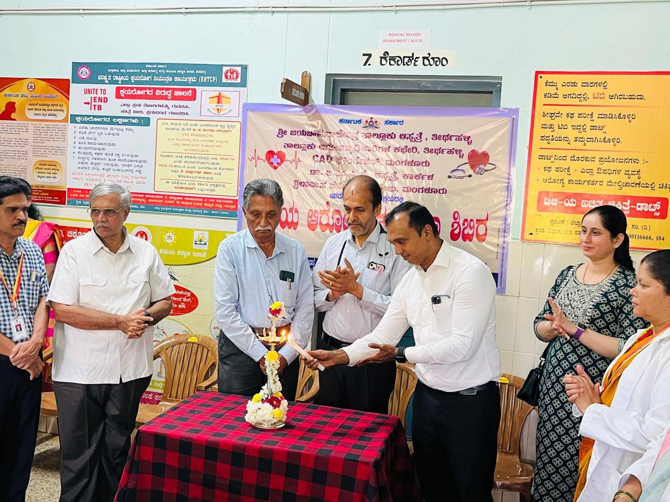
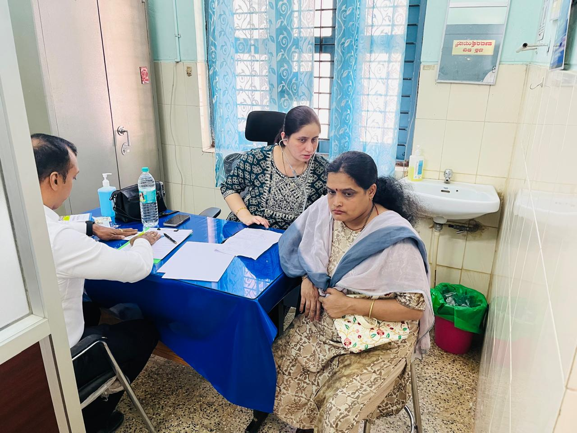
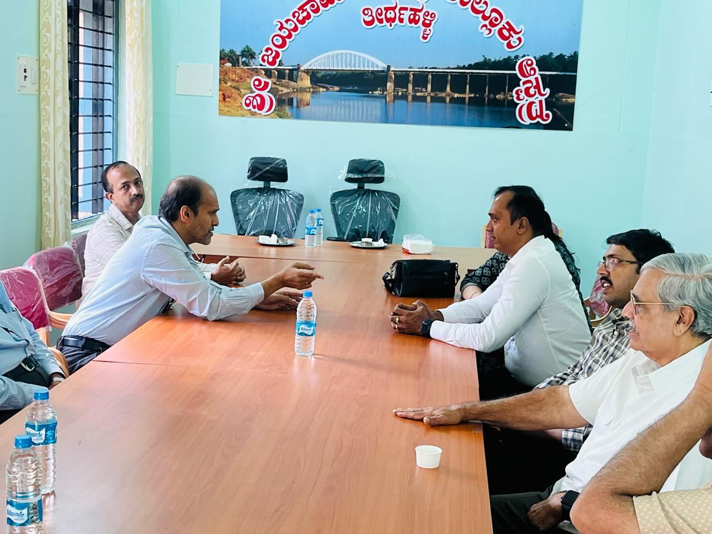
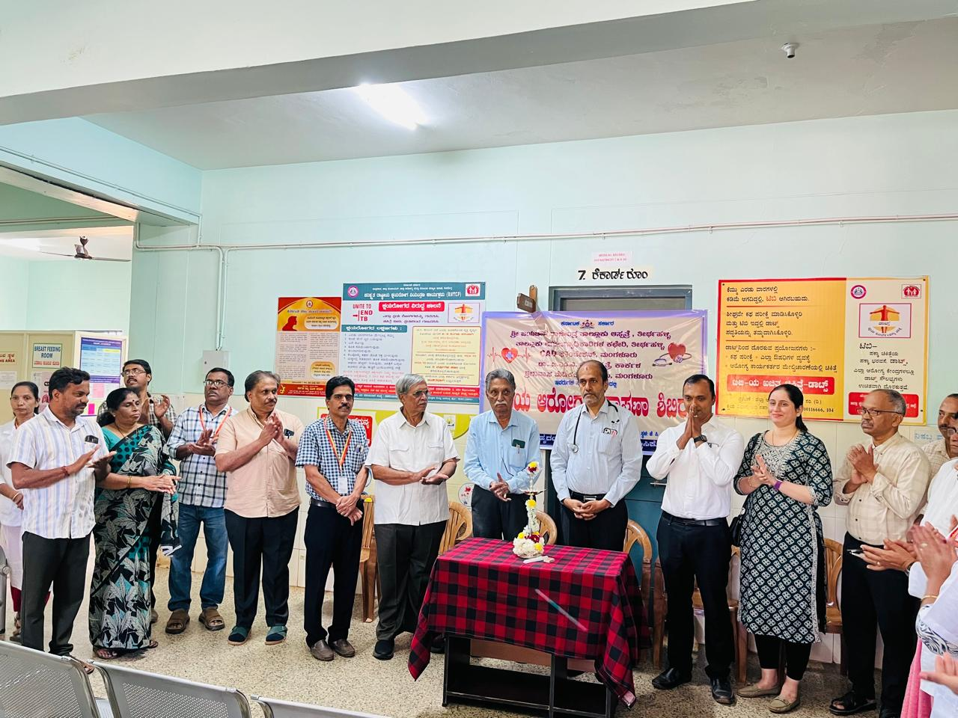

Slide 5
FREE MEDICAL CAMP
DATE – 25.01.2025
LOCATION – MAHALAKSHMI ENGLISH MEDIUM SCHOOL,UCHILA

Slide 6
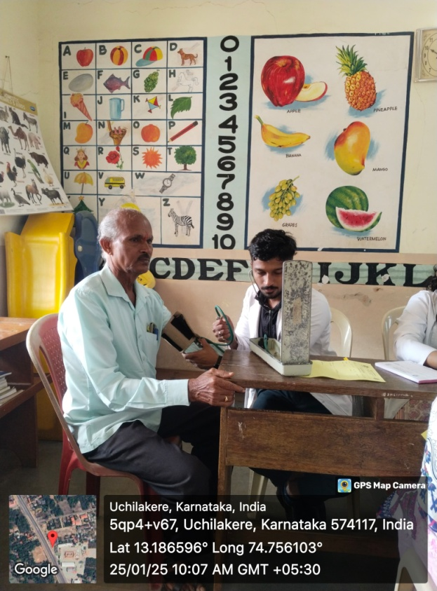
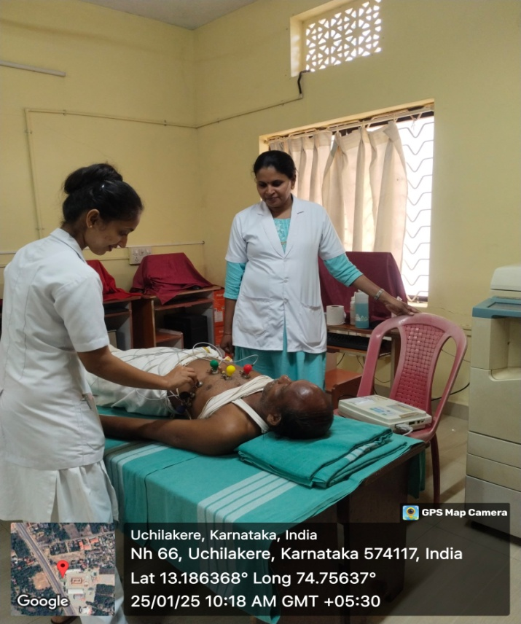
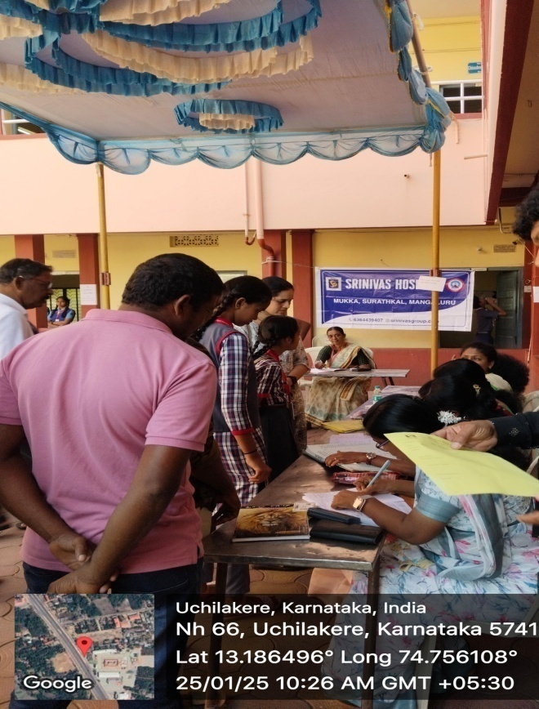

Slide 7
FREE MEDICAL CAMP
DATE – 26.01.2025
LOCATION – HASANA

Slide 8
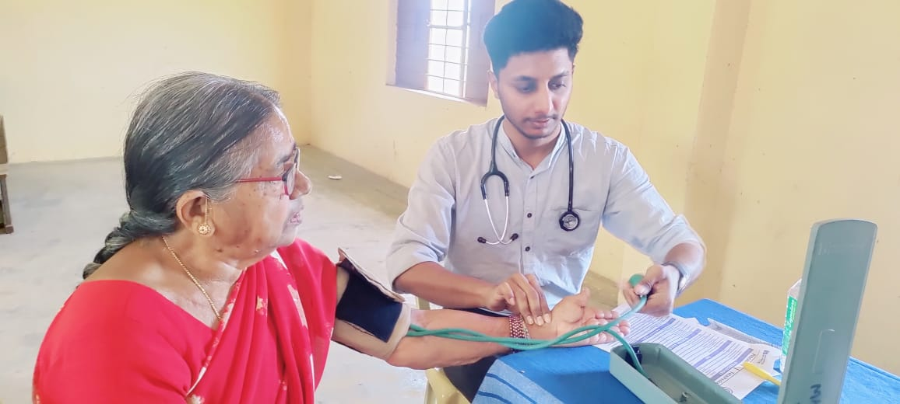
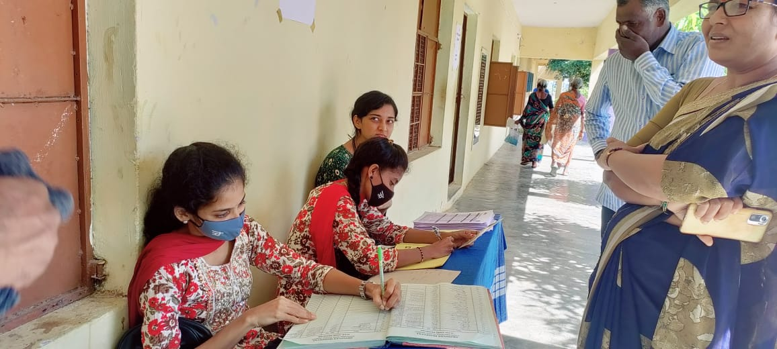
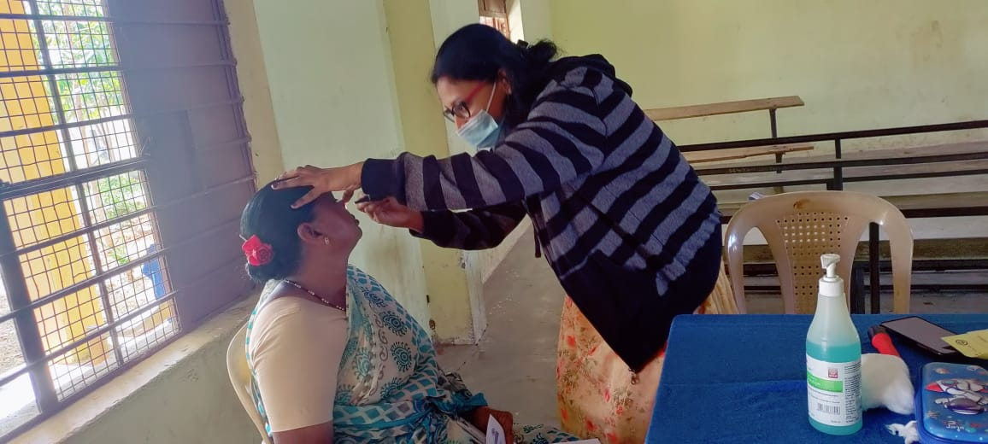

Slide 9
FREE MEDICAL CAMP
DATE – 10.02.2025
LOCATION – GOVINDA DASA COLLEGE, SURATHKAL

Slide 10
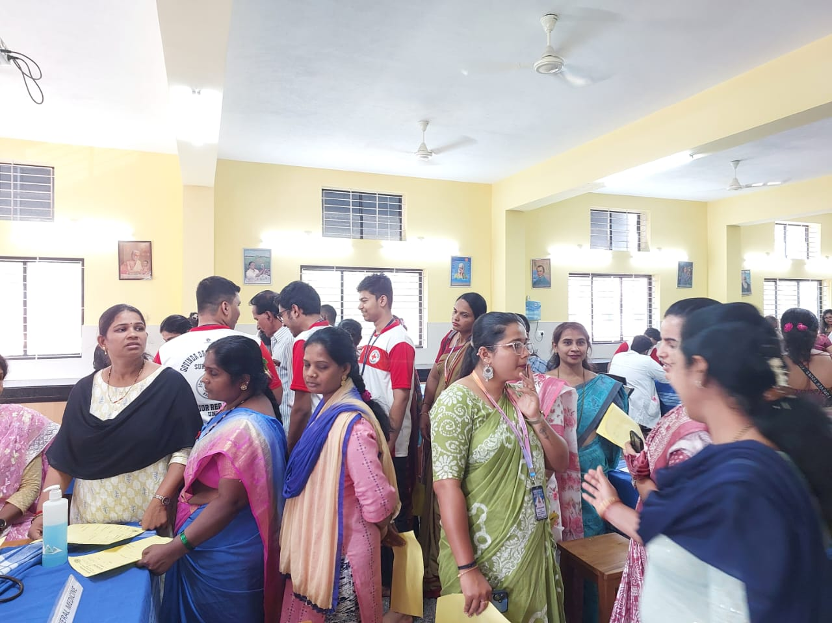
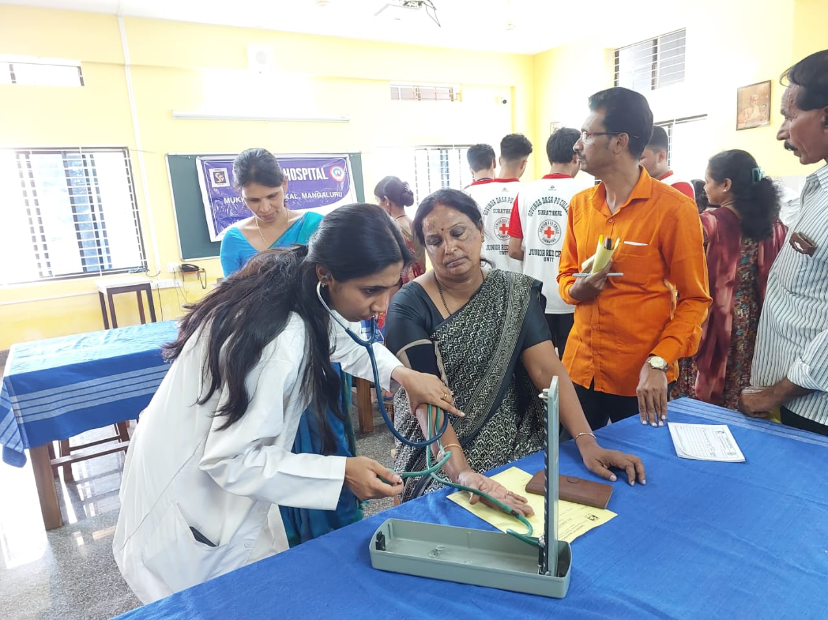
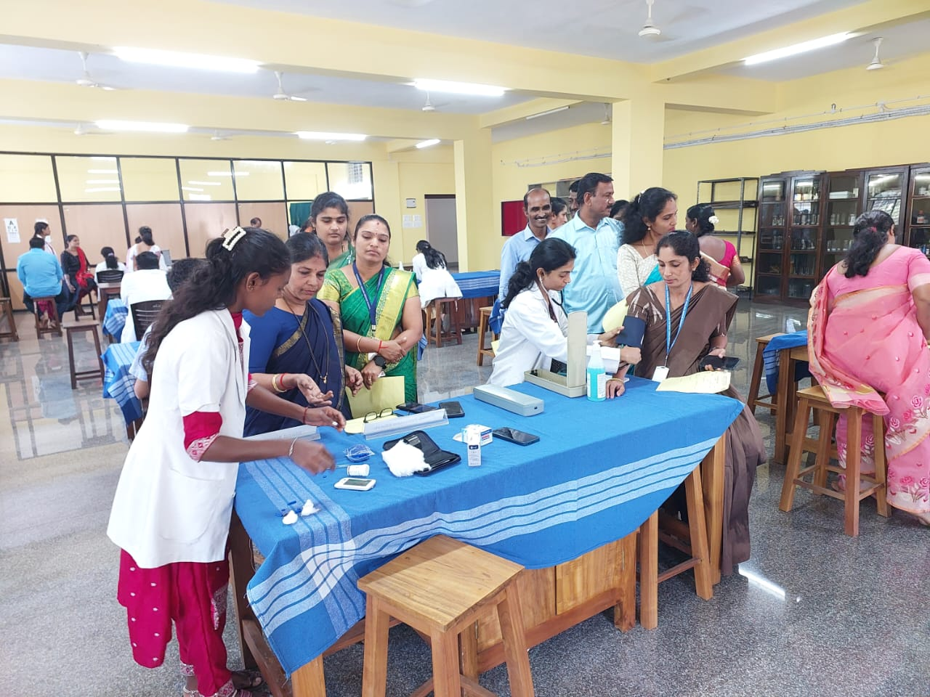
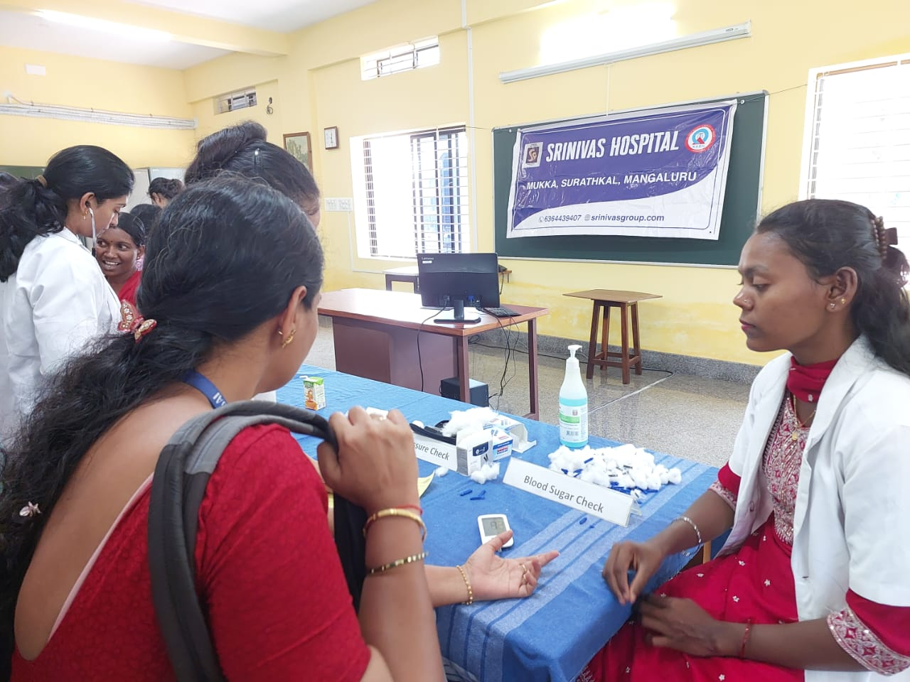

Slide 11
FREE MEDICAL CAMP
DATE – 18.02.2025
LOCATION – CONSOLIDATED CONSTRUCTION CONSORTIUM LTD., MUKKA

Slide 12
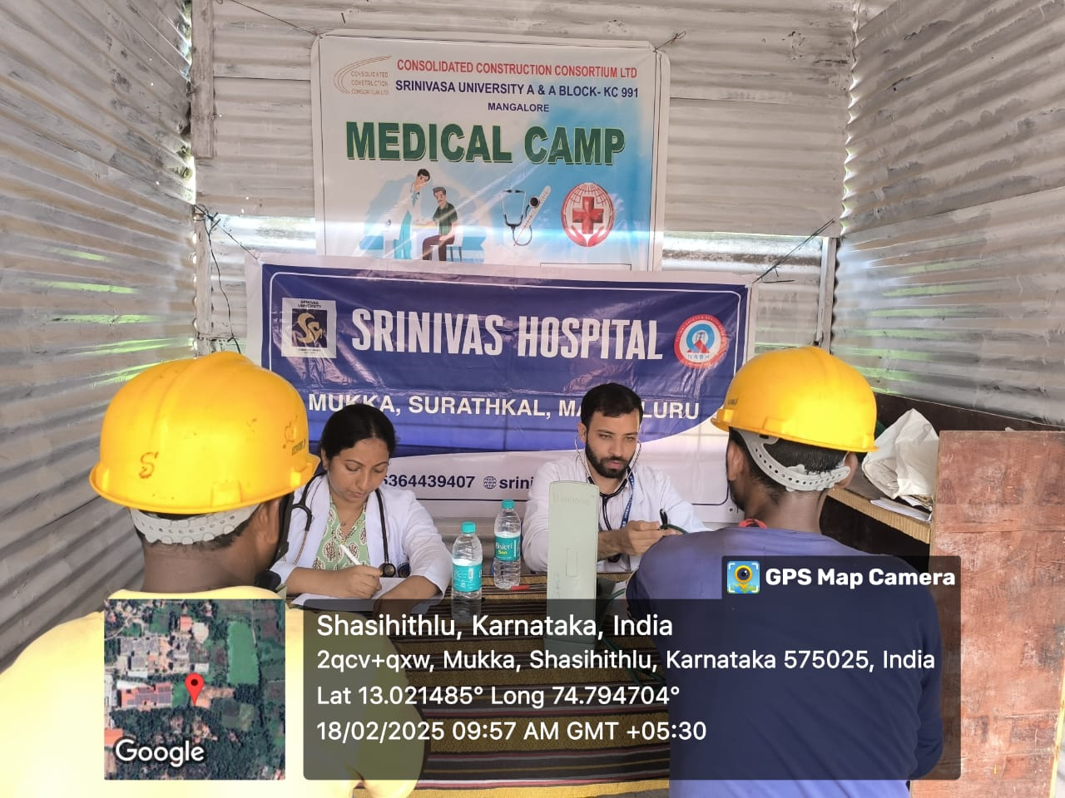
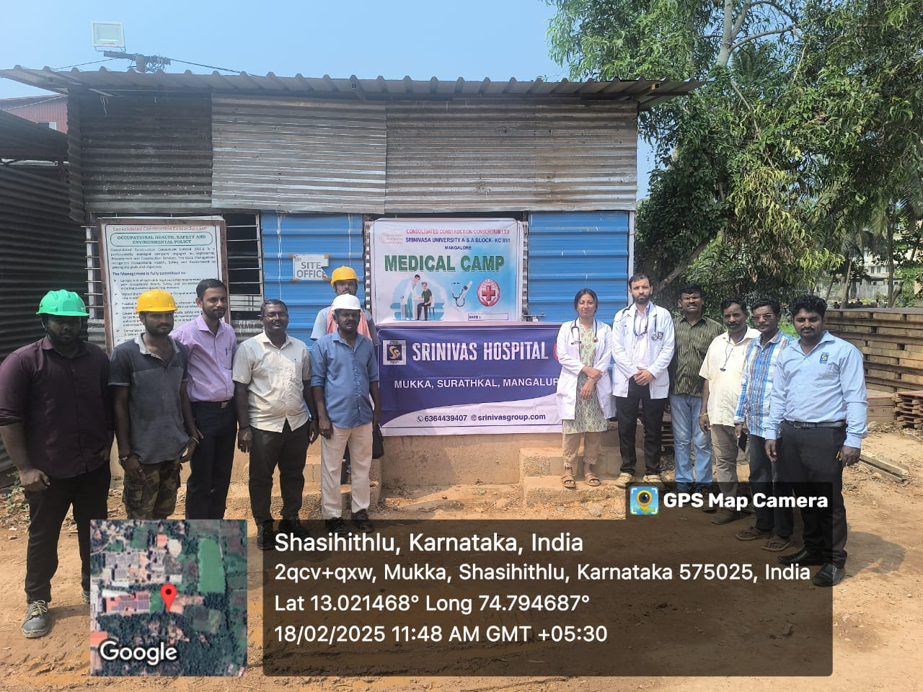
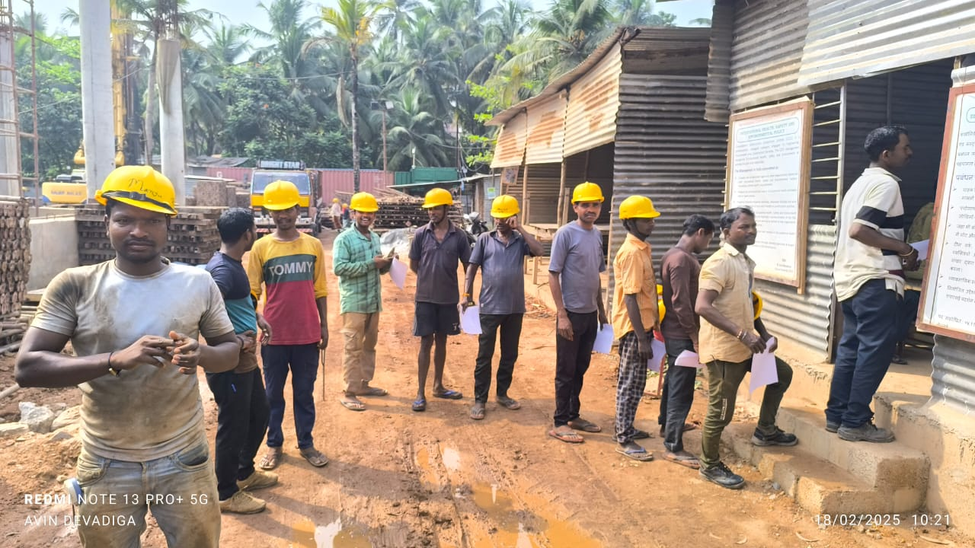
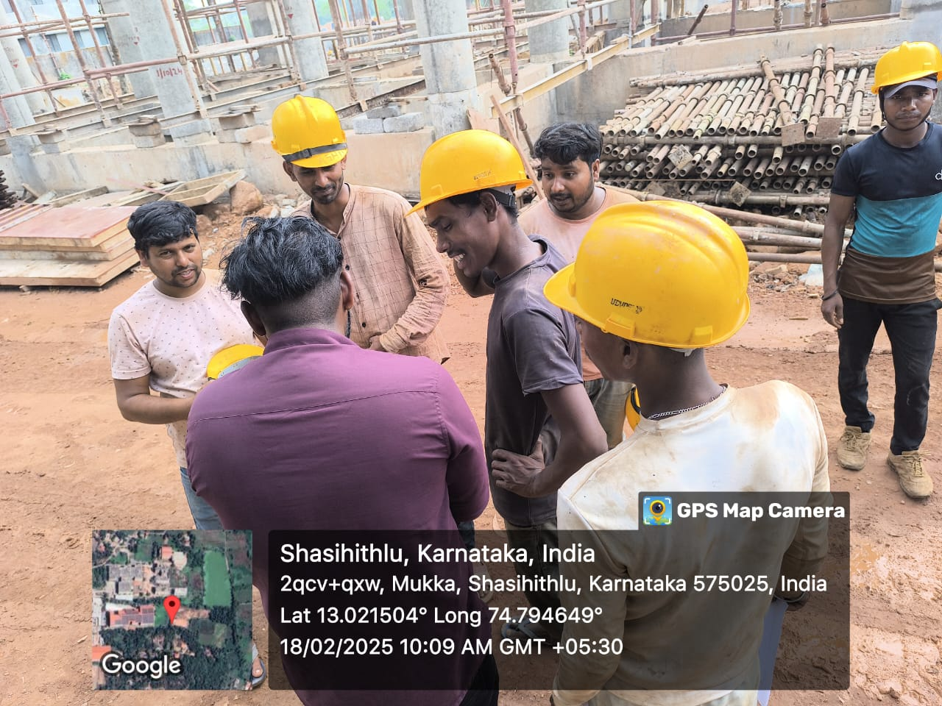

Slide 13
FREE MEDICAL CAMP
DATE – 22.02.2025
LOCATION – MUKKA PROTIENS, MUKKA

Slide 14
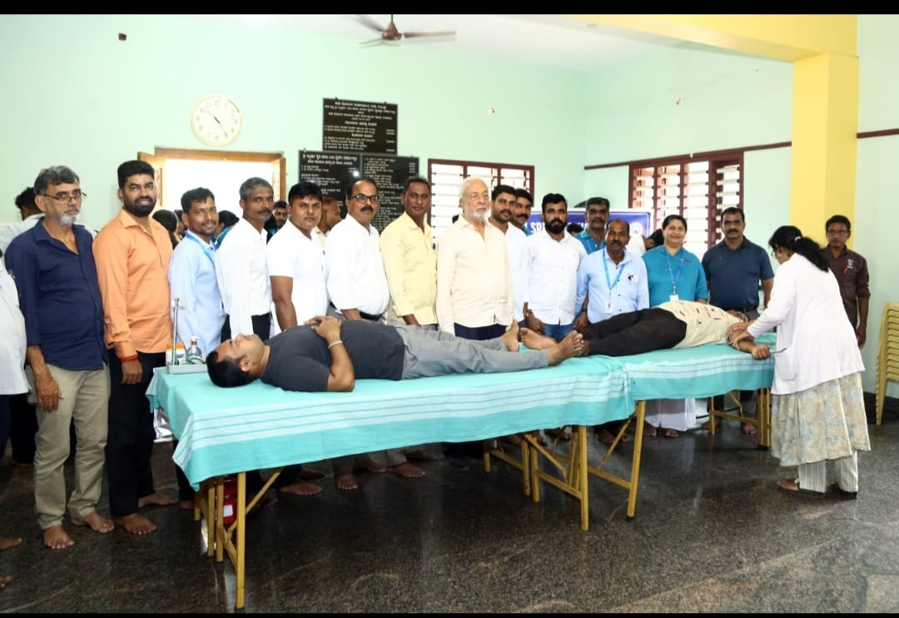
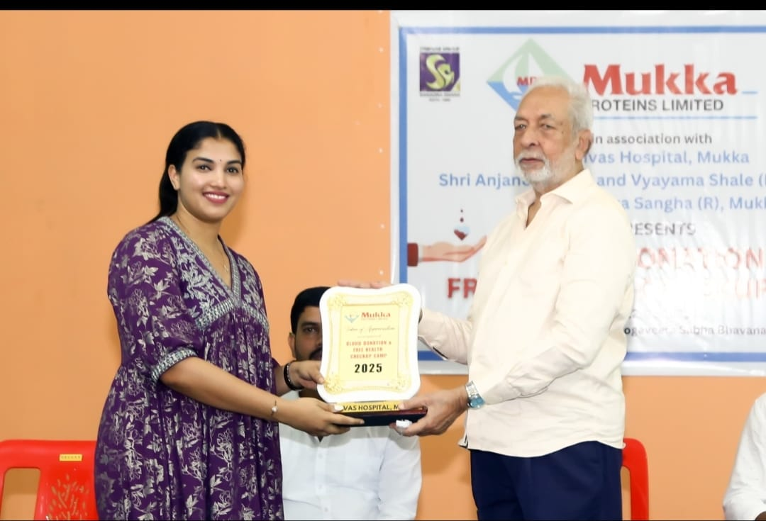
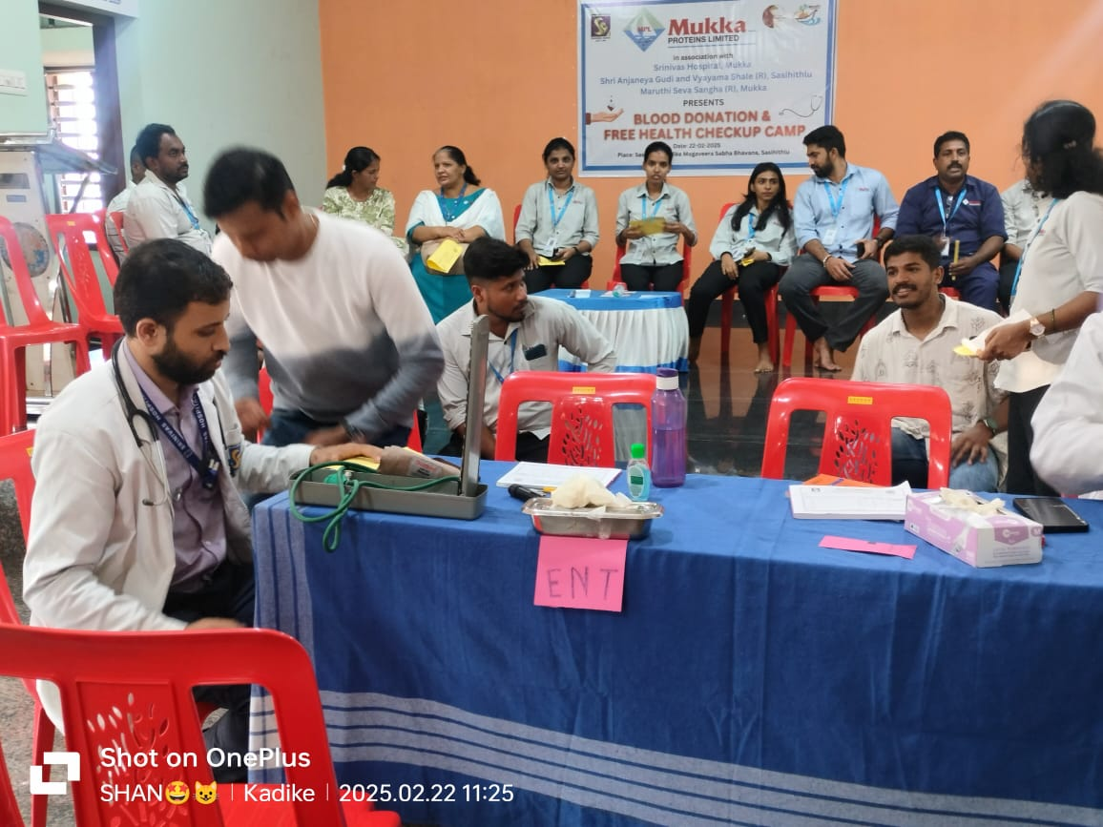
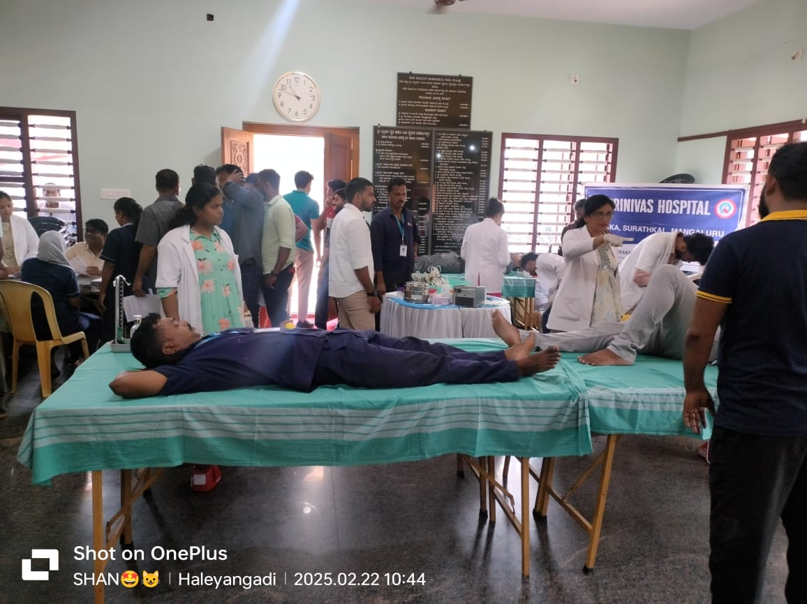

Slide 15
FREE MEDICAL CAMP
DATE – 22.02.2025 and 23.02.2025
LOCATION – PRIMARY SCHOOL, 6TH BLOCK, KRISHNAPURA

Slide 16
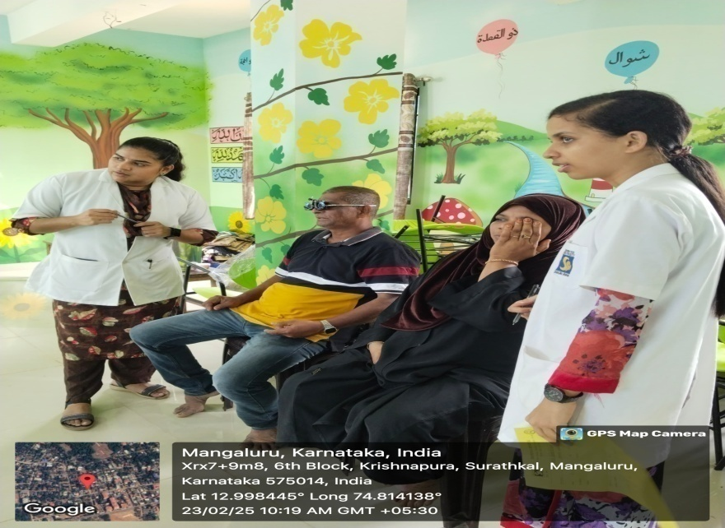

Slide 17
FREE MEDICAL CAMP
DATE – 23.02.2025
LOCATION – SHIVASHAKTHI FRIENDS CLUB, KUTHLOOR, NARAVI

Slide 18
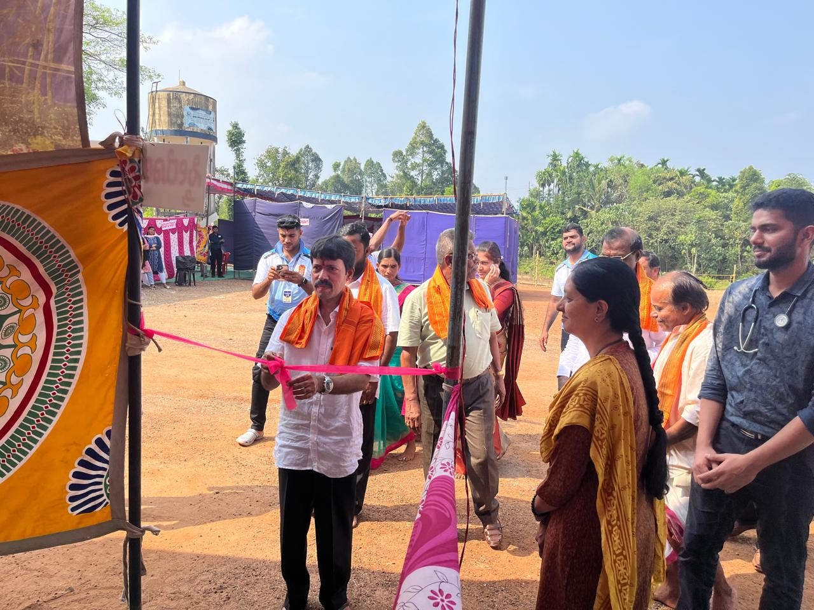
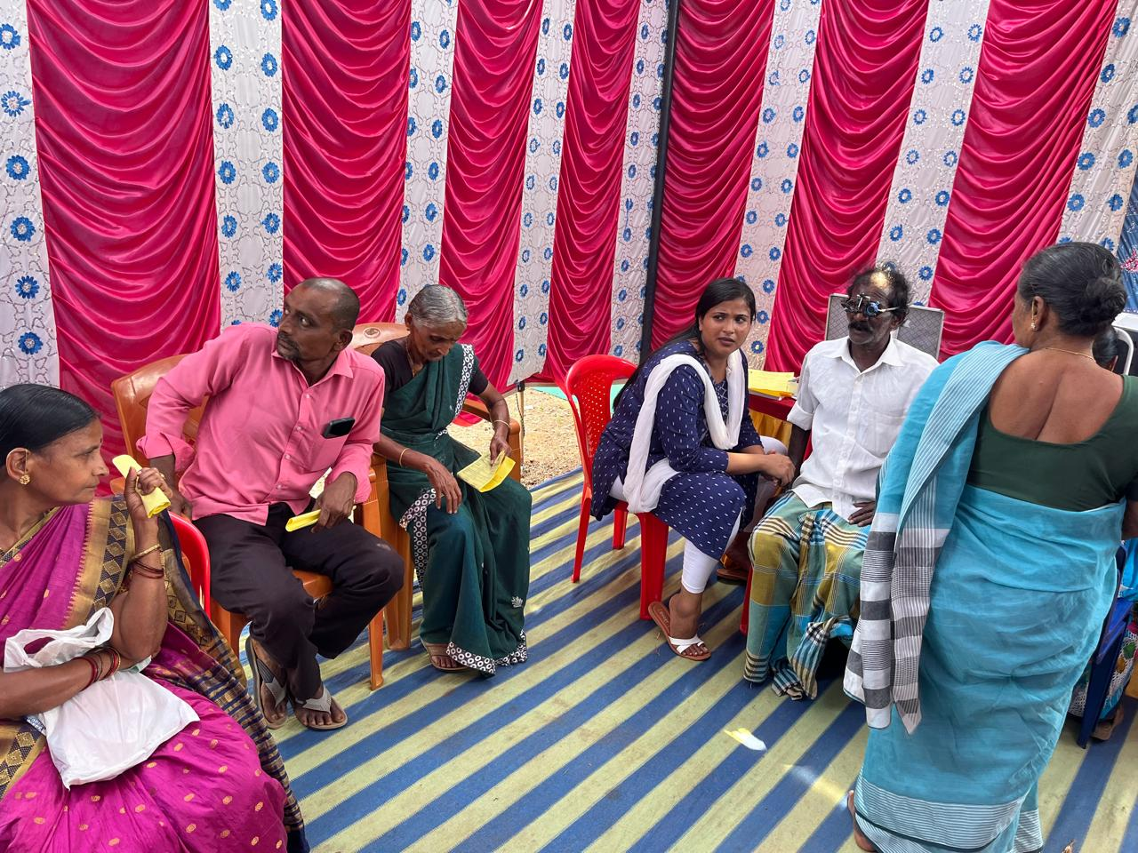
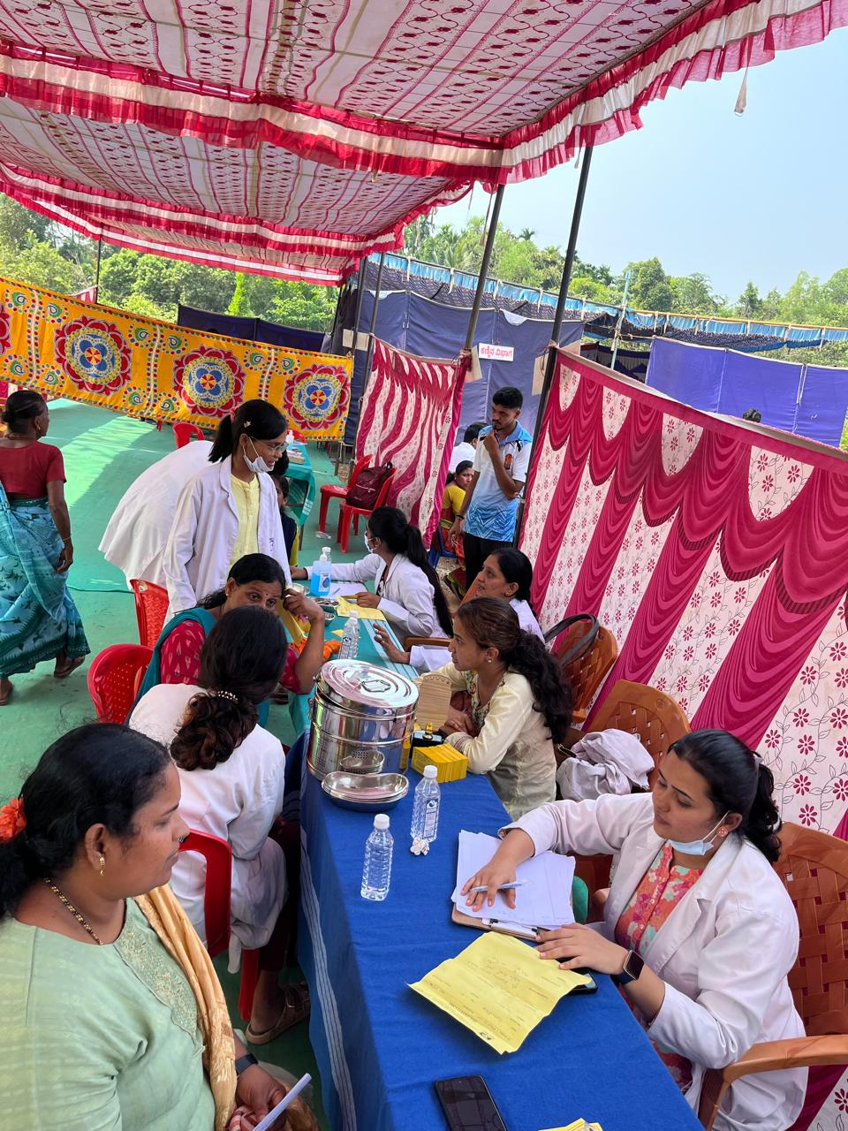
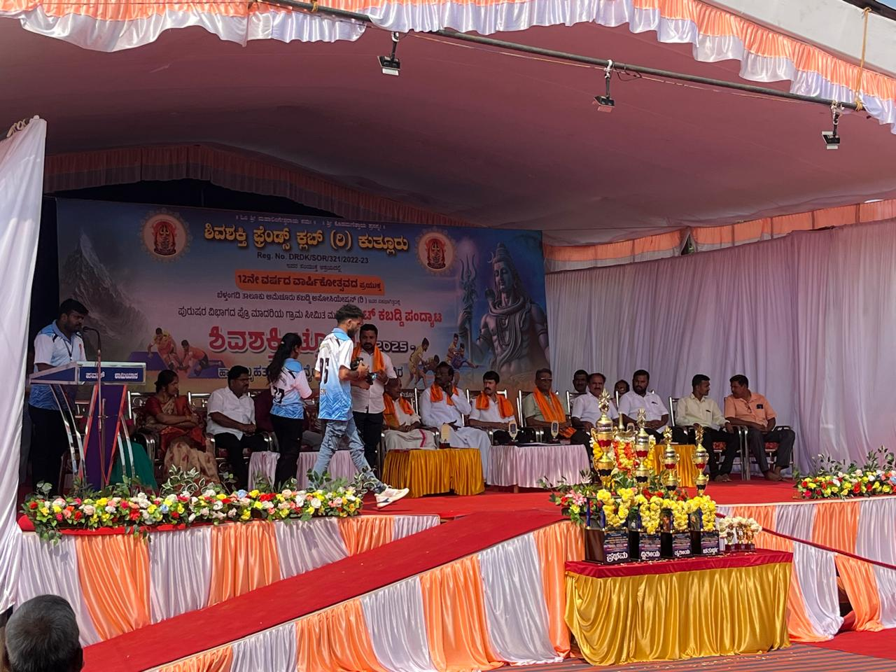

Slide 19
FREE MEDICAL CAMP
DATE – 26.02.2025 TO 05.03.2025
LOCATION – KAUP MARIGUDI TEMPLE

Slide 20
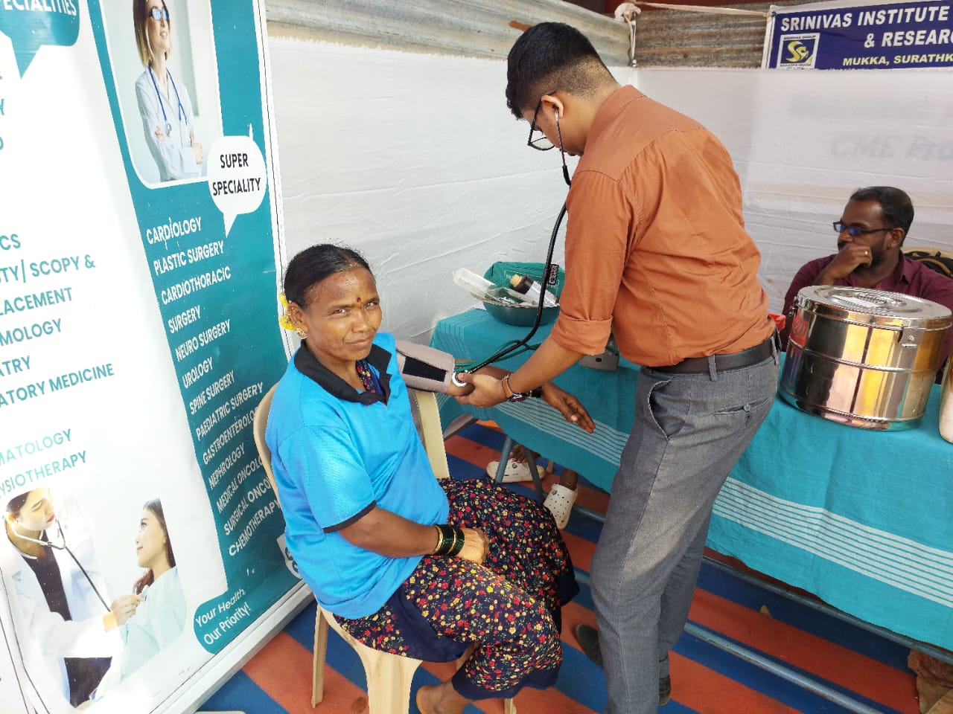
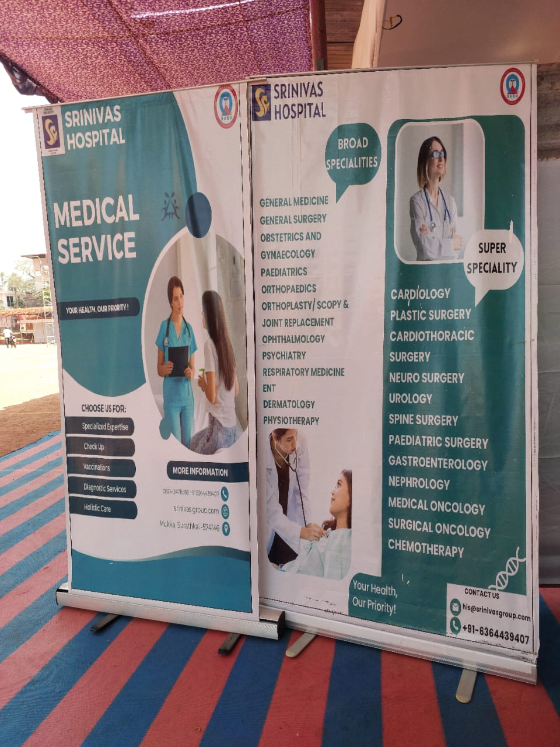
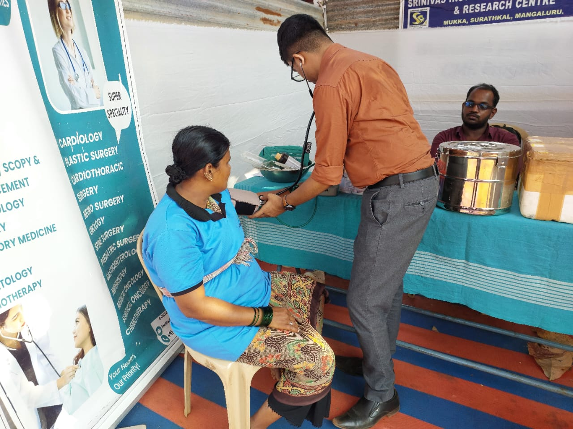
KAUP TEMPLE FREE MEDICAL CAMP

Slide 21
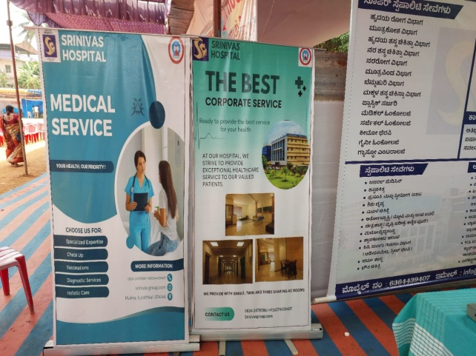
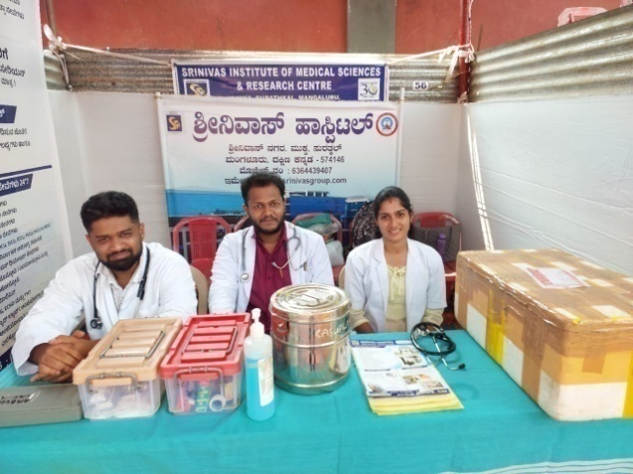
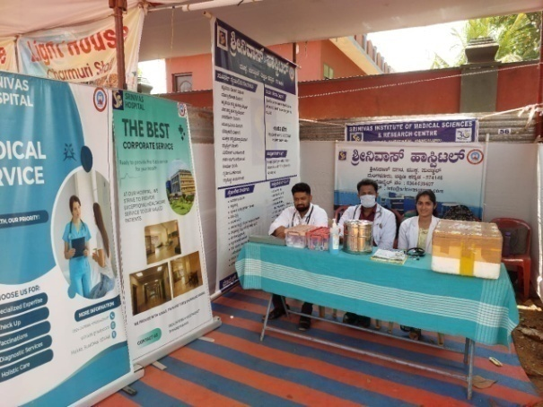
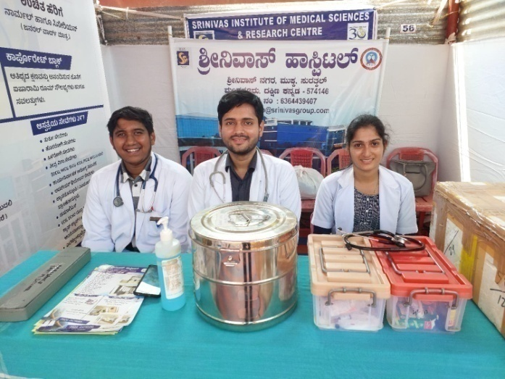
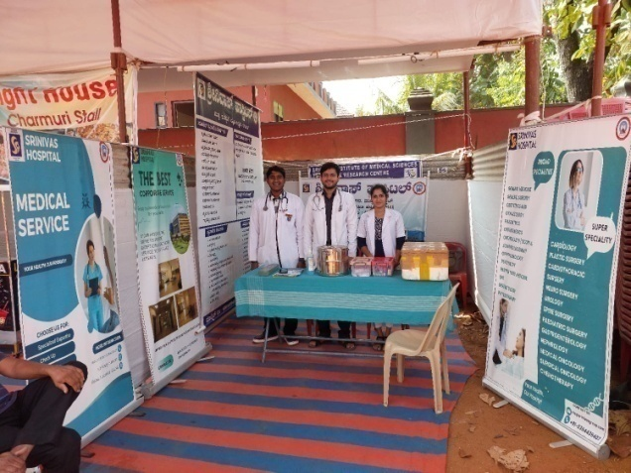
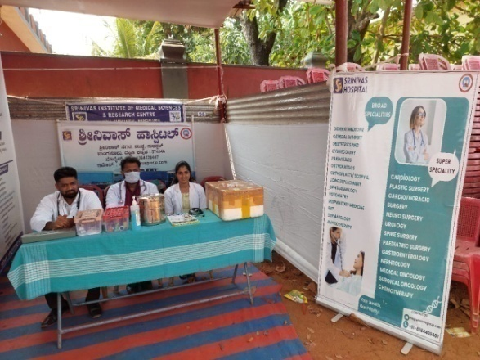
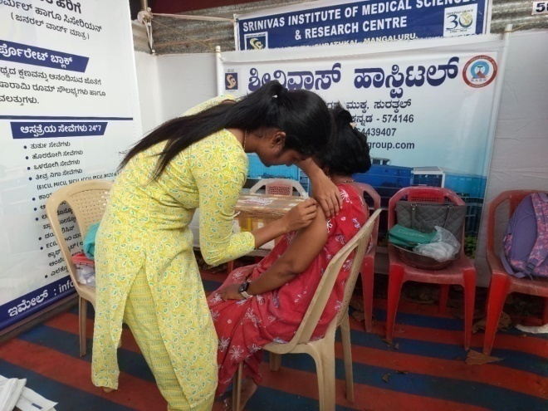
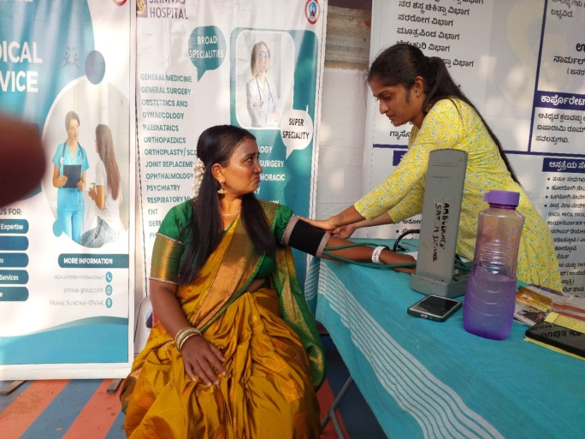
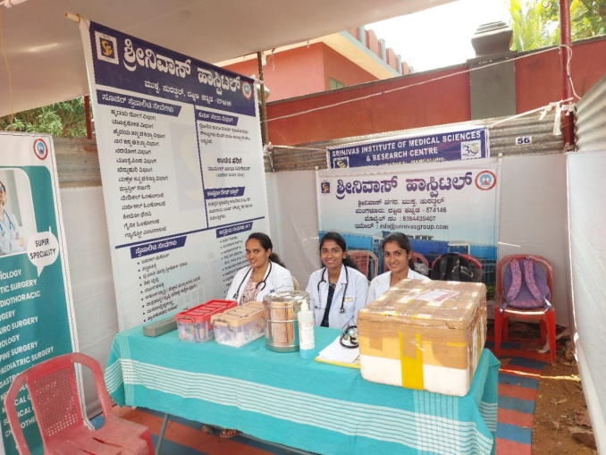

Slide 22
FREE MEDICAL CAMP
DATE – 04.03.2025
LOCATION – SUEZ HONNAKATTE AND ADYAR

Slide 23
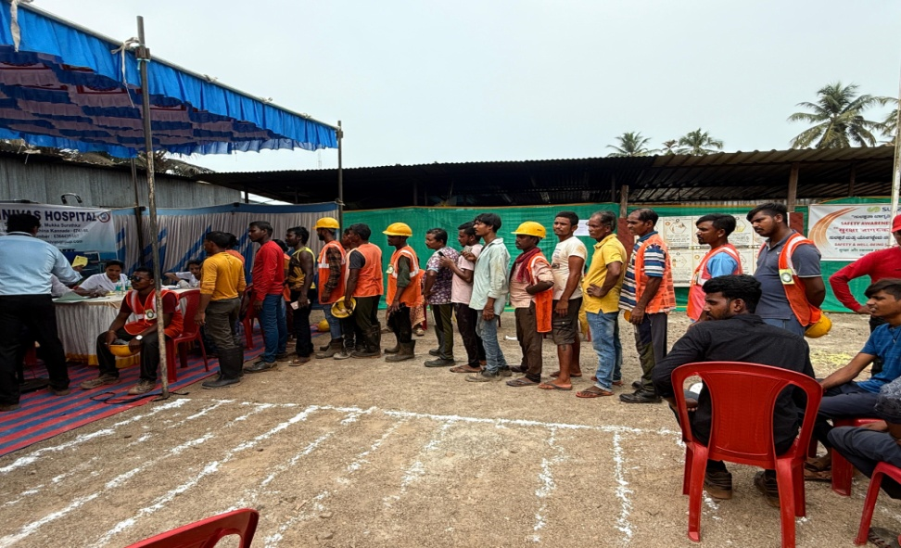
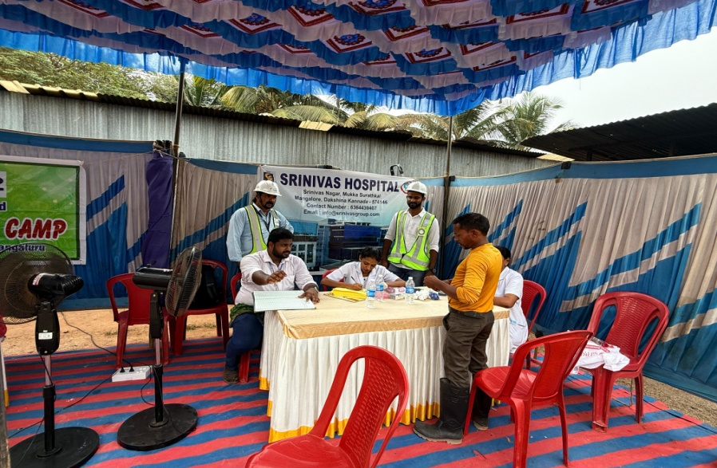
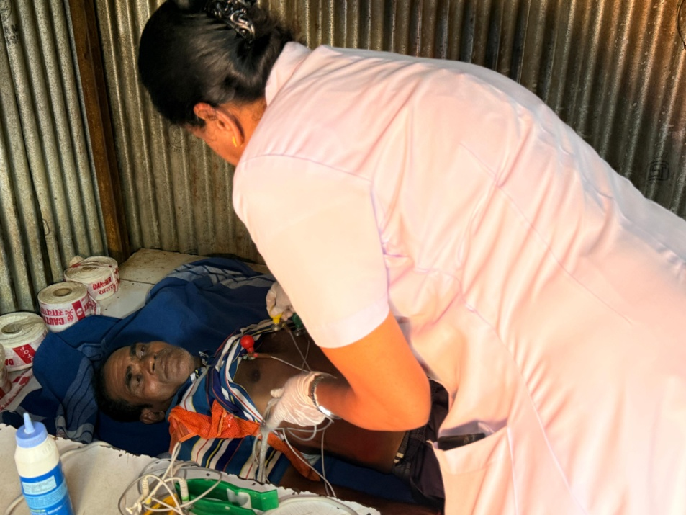
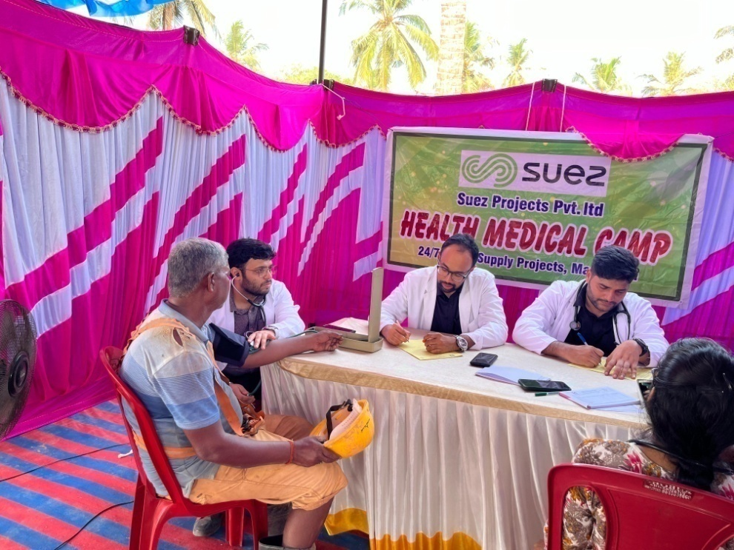

Slide 24
FREE MEDICAL CAMP
DATE – 10.03.2025
LOCATION – SUEZ COMPANY, KOTTARA CHOWKI

Slide 25
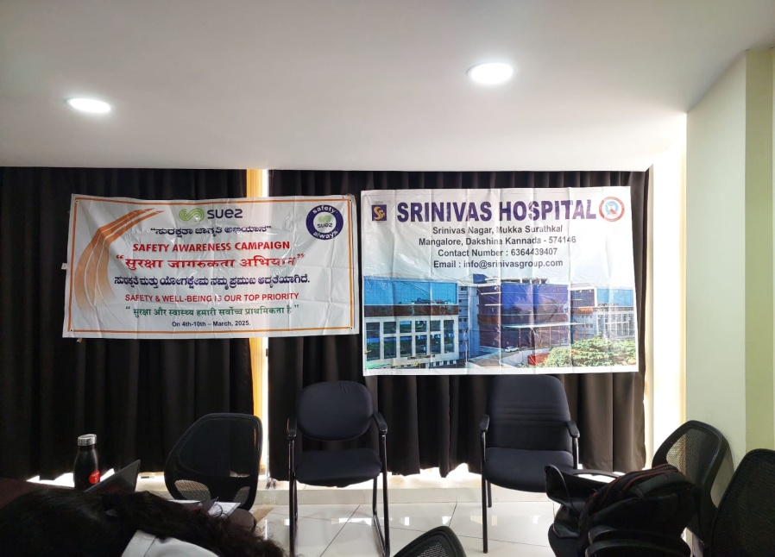
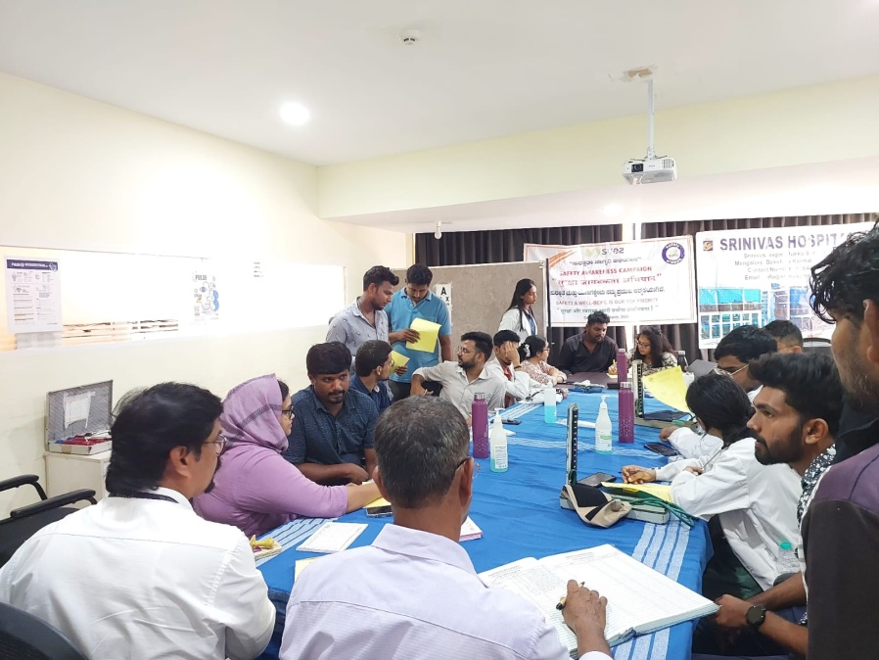
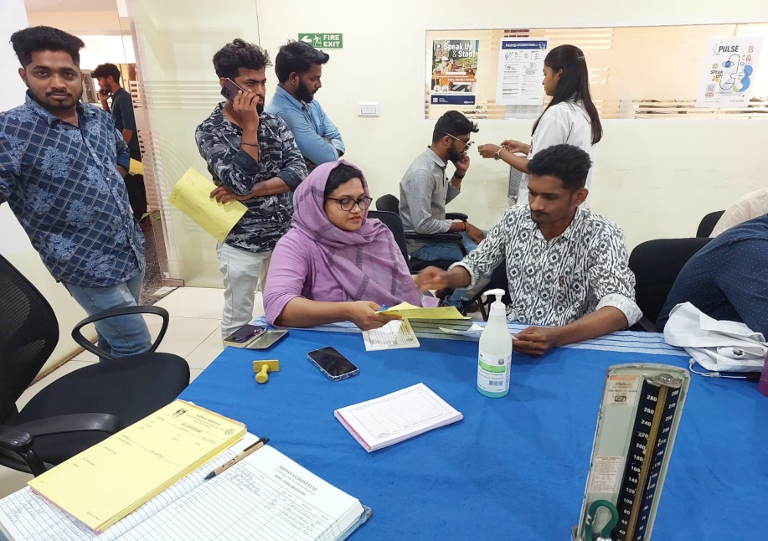

Slide 26
FREE MEDICAL CAMP
DATE – 23.03.2025
LOCATION – NARAYANA GURU SABHA BHAVANA, KOLNADU

Slide 28
FREE MEDICAL CAMP
DATE :- 03-04-2025
PLACE :- NMPA HOSPITAL, PANAMBUR, MANGALURU

Slide 30
FREE MEDICAL CAMP
DATE :- 07-04-2025
PLACE :- VALACHIL COLLAGE CAMPUS, VALACHIL, MANGALURU.

Slide 32
FREE MEDICAL CAMP
DATE :- 13-04-2025
PLACE :- NEAR KANNANGHAR JUMMA MASJID, HEJAMADI

Slide 34
FREE MEDICAL CAMP
DATE :- 14-05-2025
PLACE :- ADANI POWER PLANT, MUDHARANGADI, PADUBIDRI

Slide 36
FREE MEDICAL CAMP
DATE :- 25-05-2025
PLACE :- TAILORS ASSOCIATION, SURATHKAL,
MANGALURU

